Slide 1
Animated Interfaces for List Comparison Medication Reconciliation and Product Comparison
Catherine Plaisant
with Tiffany Chao, Ran Liu, Ben Shneiderman
Human-Computer Interaction Lab
University Of Maryland
SOH-2012

Slide 2
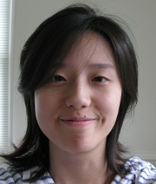
Animated Interfaces for List Comparison Medication Reconciliation and Product Comparison
Catherine Plaisant
with Tiffany Chao, Ran Liu, Ben Shneiderman
Human-Computer Interaction Lab
University Of Maryland
SOH-2012

Slide 3
~ Original Motivation ~ Medication Reconciliation
Problem proposed by our sponsor: Office of the National Coordinator for Health Information Technology
Notes:
A task doctors are asked to do in many situations: For example Imagine that this is what the patient told me he was taking last month… but today he is telling you he is taking this

Slide 4
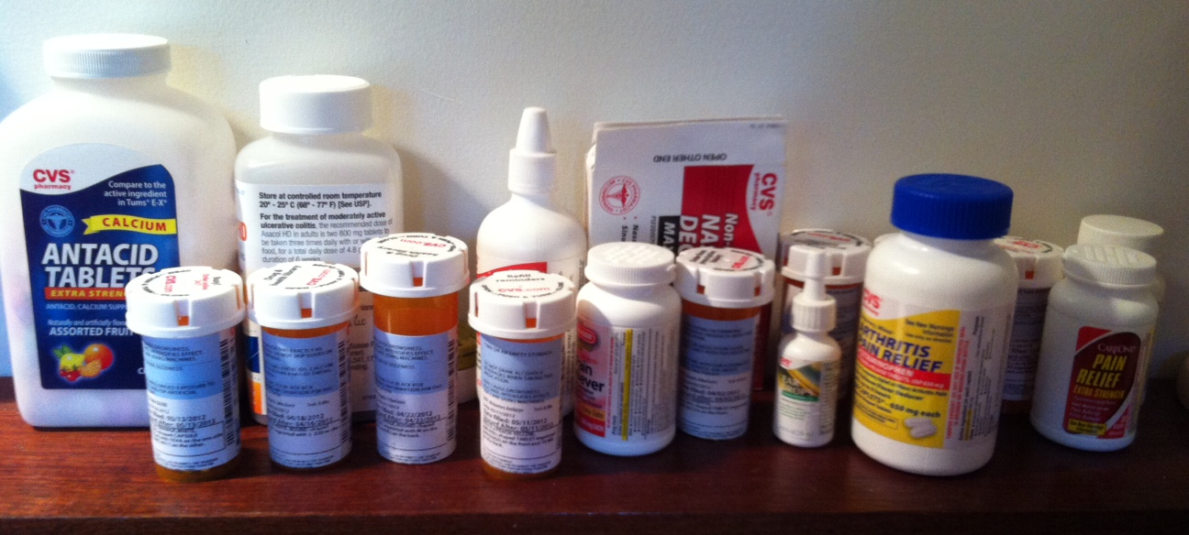
~ Original Motivation ~ Medication Reconciliation
Problem proposed by our sponsor: Office of the National Coordinator for Health Information Technology
Notes:
What’s the same, what’d different?

Slide 5
List 1
List 2

Slide 6
List 1
List 2
compare

Slide 7
List 1
List 2
compare
And for each med keep or not?

Slide 8
List 1
List 2
Reconciled list

Slide 9
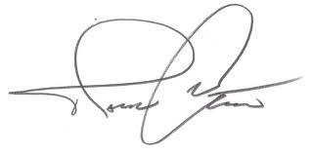
List 1
List 2
Reconciled list
Signoff

Slide 10
~ Many Situations ~ e.g. today (interview) vs. last visit (EHR) my EHR vs. Pharmacy system EHR1 vs. EHR2 During Transitions of Care e.g. Hospital to Home
Notes:
May be seen as the process of updating or synchronizing lists, it also involves clinical decisions about what drugs to continue or discontinue. A good example is the reconciliation that needs to take place during transitions of care. E.g. hosp to home

Slide 11
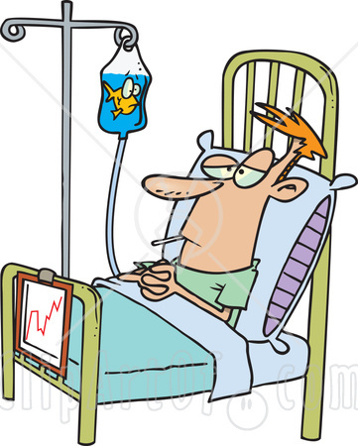
Example Scenario : Hospital Discharge
Home Meds reported during Intake Interview
Meds administered while at hospital
Meds patient should take after going home

Slide 12
Example Scenario : Hospital Discharge
Home Meds reported during Intake Interview
Meds administered while at hospital
What is unique?
What is identical?
What is similar/equivalent?
What should be stopped/continued?
Notes:
Some drugs may be the same, but the dosage or frequency may have changed (return to original or continue what was done at hospital?) NEW drugs at the hospital given when problem was acute and might be stopped. Some drugs taken at home may have been stopped temporarily (like vitamins or supplements)

Slide 13
Example Scenario : Hospital Discharge
Home Meds reported during Intake Interview
Meds administered while at hospital
Notes:
Some drugs may be the same, but the dosage or frequency may have changed (return to original or continue what was done at hospital?) NEW drugs at the hospital given when problem was acute and might be stopped. Some drugs taken at home may have been stopped temporarily (like vitamins or supplements)

Slide 14
Example Scenario : Hospital Discharge
Home Meds reported during Intake Interview
Meds administered while at hospital
Notes:
Some drugs may be the same, but the dosage or frequency may have changed (return to original or continue what was done at hospital?) NEW drugs at the hospital given when problem was acute and might be stopped. Some drugs taken at home may have been stopped temporarily (like vitamins or supplements)

Slide 15
Example Scenario : Hospital Discharge
Home Meds reported during Intake Interview
Meds administered while at hospital
X
Notes:
Some drugs may be the same, but the dosage or frequency may have changed (return to original or continue what was done at hospital?) NEW drugs at the hospital given when problem was acute and might be stopped. Some drugs taken at home may have been stopped temporarily (like vitamins or supplements)

Slide 16
Example Scenario : Hospital Discharge
Home Meds reported during Intake Interview
Meds administered while at hospital
Notes:
Some drugs may be the same, but the dosage or frequency may have changed (return to original or continue what was done at hospital?) NEW drugs at the hospital given when problem was acute and might be stopped. Some drugs taken at home may have been stopped temporarily (like vitamins or supplements)

Slide 17
Example Scenario : Hospital Discharge
Home Meds reported during Intake Interview
Meds administered while at hospital
Reconciled list

Slide 18
Levels of equivalence
Equivalence | Criteria | Example
Form Equivalence | Identical except for brand vs. generic | Advil = Ibuprofen Senormin = Atenolol
Functional Equivalence | Same therapeutic intent | Atenolol and Propanolol both betablockers
Partial Equivalence | Form or functional equivalence, but differ in dosage, frequency, or route | Advil 100 mg Acetaminophen 200mg
No equivalence | Unique in form and function
“Automated medication reconciliation and complexity of care transitions” Bozzo Silva, Bernstam, Markowitz, Johnson, Zhang and Herskovic, AMIA 2011

Slide 19
Twinlist spatial layout and multi-step animation to show similarities and differences and to prepare the reconciled list

Slide 20
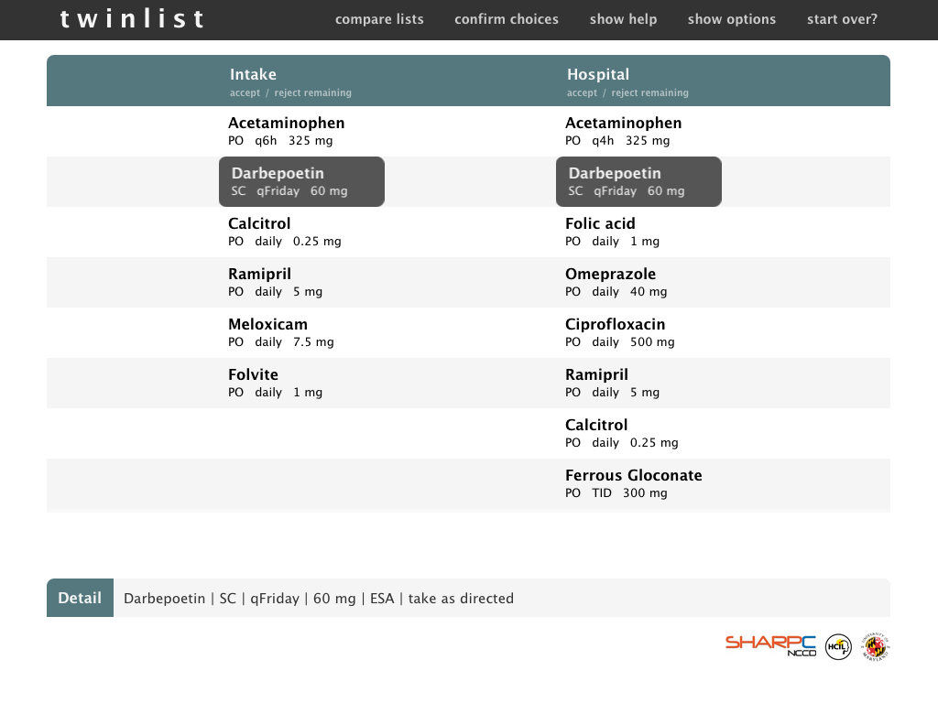
Open source BSD License (HTML5, CSS3, and JavaScript; using jQuery)

Slide 21
Very well received

Slide 23
Variations by others

Slide 24
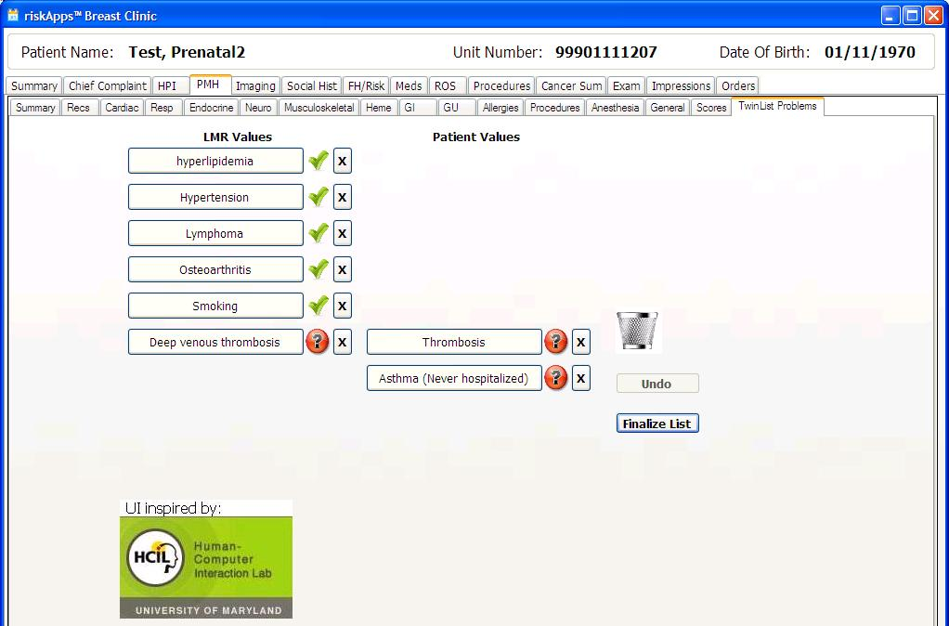
e.g. problem list reconciliation in cancer risk assessment (Hughes riskApps™)

Slide 25
Dissemination initiated

Slide 26
Dissemination initiated
Available open source
HTML5, CSS3, and JavaScript (using jQuery)
Documentation ~ see www.cs.umd.edu/hcil/sharp

Slide 27
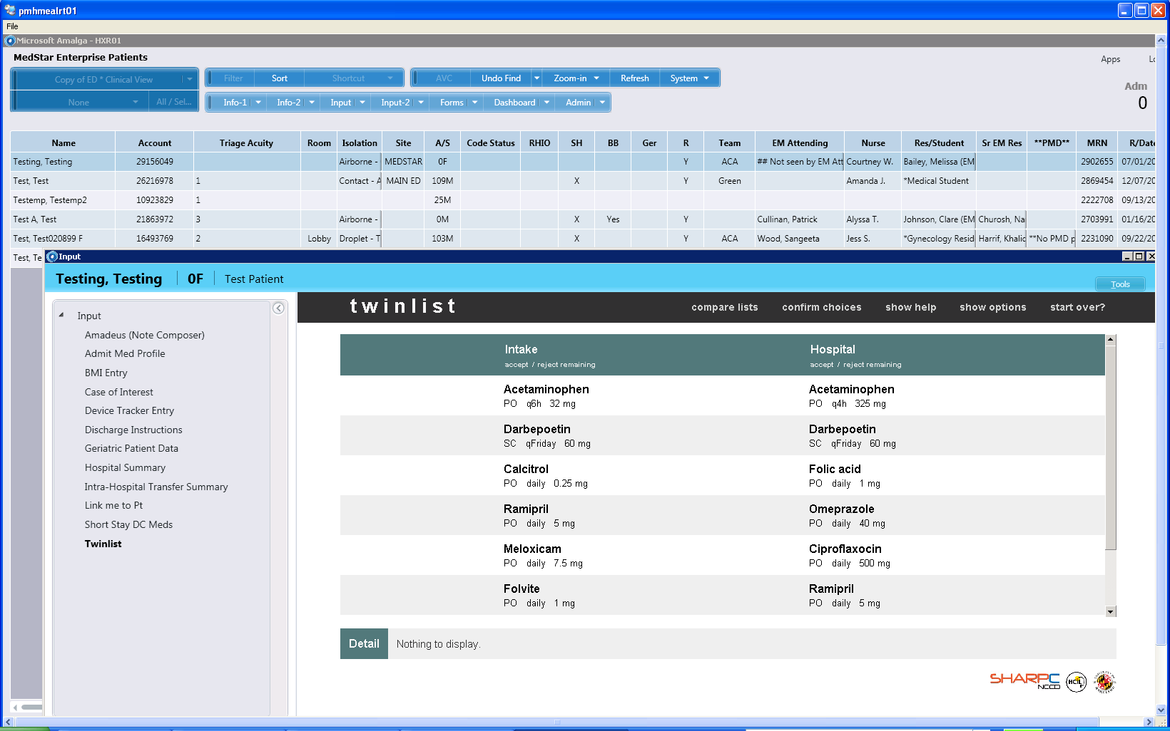
e.g. Twinlist running on Microsoft Amalga Platform

Slide 28
e.g. Twinlist running on Microsoft Amalga Platform
Evaluation
As soon as possible
Clinicians
Better decisions?
Fewer errors?
Faster?

Slide 29
Evaluation
Now
20 Students
Role of animation?

Slide 30
Does animation help participants learn on their own?
NO animation: ?????????-
Animation: ???-------
Hardest thing? Understanding the connection between similar pairs
9/10
needed clarifications
3/10 needed clarifications

Slide 31
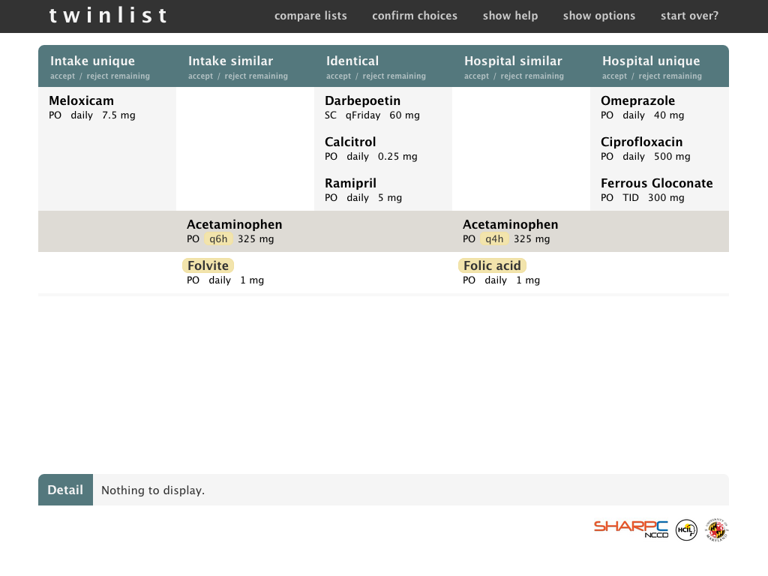

Slide 33
Does animation slow task completion?
Literature says “not always the case”
Here it does (extra = time of the animation = 6-10 sec)
Some comments suggest benefits
“I think the [animated version] took the same amount of time”
“I think I would make mistakes with the fast version”
“Nice to be reminded of why things are were they are”

Slide 34
Preferences?
Use animation to get started?
18/20 YES
Use animation for regular work?
16/20 NO

Slide 35
5/20 forgot to scroll with long lists
→ confirms need to check completeness
[Right-click to reject] not discovered but state rotation was…

Slide 36
Open source BSD License (HTML5, CSS3, and JavaScript; using jQuery)

Slide 37
Another application of same principles

Slide 38
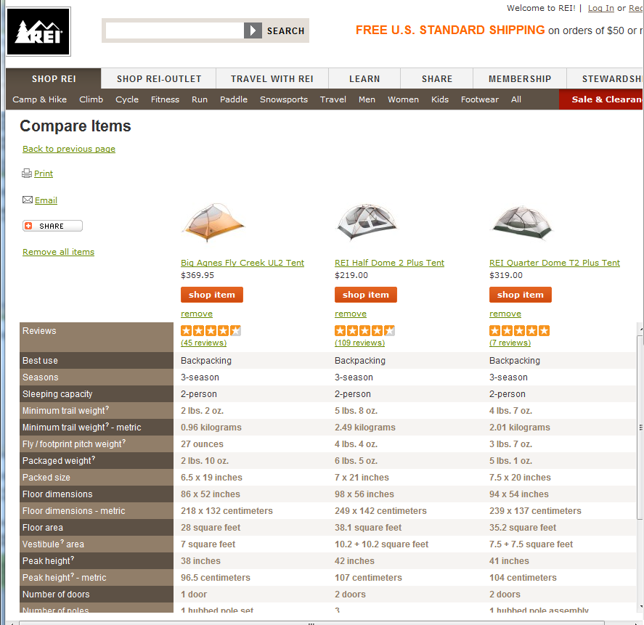
Product Comparison
No reconciliation action
Often more than 2 lists More features to compare
Features have “goodness”

Slide 39
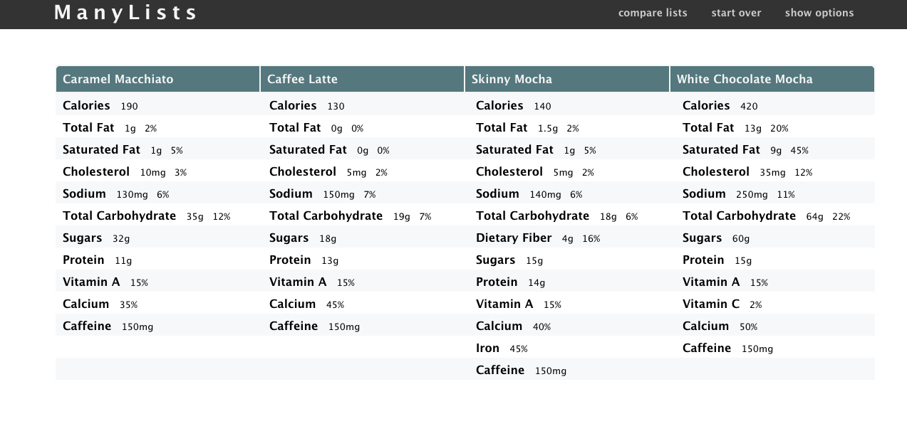
ManyLists
www.cs.umd.edu/hcil/manylists
Available for licensing
Contact UMd Office of Technology Commercialization

Slide 40
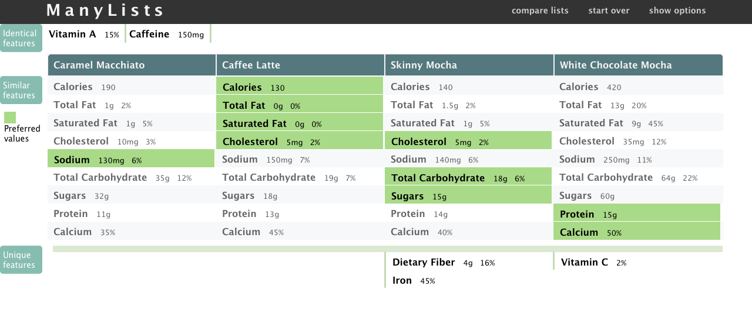
ManyLists
www.cs.umd.edu/hcil/manylists
Available for licensing
Contact UMd Office of Technology Commercialization

Slide 41
Conclusions - Consider using spatial layout for comparison - Multi-step animations can help users learn plaisant@cs.umd.edu
www.cs.umd.edu/hcil/sharp
www.cs.umd.edu/hcil/manylists
Acknowledgements - Strategic Health IT Advanced Research Projects Program (SHARP) Office of the National Coordinator for Health Information Technology (Grant Number 10510592) - SHARP colleagues: Eliz Markowitz, Elmer V. Bernstam, Jorge Herskovic, Todd R. Johnson, Jiajie Zhang - All the physicians who provided feedback (especially Zach Hettinger from Washington Hospital Center)
- Students of CMSC734 Information Visualization class: Leo Claudino, Sameh Khamis, Ben London, Jay Pujara

Slide 42
Extra

Slide 43
